Slide 1
Mission Briefing
Version 58
Notes:
This briefing provides an overview of the Air Force Sustainment Center and the eight major organizations within the command.
This briefing also highlights how we sustain and enable critical components of the nuclear enterprise.
One of the key “take-aways” from this overview is how each of the eight organizations in the Air Force Sustainment Center work together to enable combat readiness across our Air Force.

Slide 2
Air Force Sustainment Center
MISSION
Provide sustainment and logistics readiness to deliver combat power for America
VISION
Professional Airmen delivering agile logistics and sustainment
Notes:
Our mission is to deliver Combat Power for America...through sustainment activities and through Logistics readiness, including depot-level maintenance, the supply chain, and air base operating activities.
We capitalize “L” in Logistics to represent the 7 core functions of Logistics as identified in Joint Publication 4.0, Joint Logistics (Fig II-1. Core Logistics Functions).Deployment and Distribution, Supply, Maintenance, Logistics Services, Operational Contract Support, Engineering, Health Services
As we look forward, our vision for the future is that we will deliver globally integrated and agile Logistics and sustainment solutions for our Joint Force Commanders….As the strategic operating environment changes, we will evolve and adapt accordingly.
Side Note:
Sustainment is one of the six joint functions (command and control [C2], intelligence, fires, movement and maneuver, protection, and sustainment) described in Joint Publication (JP) 3-0, Joint Operations. Sustainment can determine the depth, pace, and endurance of operations.

Slide 3
Strategic Goals
Deliver cost-effective combat readiness
Deliver supply chain readiness to enable combat power
Develop mission assurance enablers
Develop and support Airmen
Notes:
These are our priorities and they are reflected in our Strategic Plan.
Our number one job is to deliver combat power through our Air Logistics Centers, our Supply Wings, and from our Air Base Wings.
We are focused on accelerating Logistics integration across the globe as we shape the future of the Global Logistics enterprise and our ability to Command and Control Logistics in the current and future strategic operating environments.
Since the Air Force Sustainment Center stood up in 2012, our focus has been on delivering more combat capability with fewer dollars…we maximize efficiency without sacrificing effectiveness. We have realized billions in cost avoidance and savings by driving “cost consciousness” into our management teams and workforce.
We are only as good as the people on our team, therefore we prioritize development and support for our Total Force Airmen…active duty, reserve, guard, civilians, and contractors. Whenever we talk about Airmen, we talk about ALL our Airmen…we are a single team that is sustaining our Air Force today and preparing for the challenges of tomorrow.

Slide 4

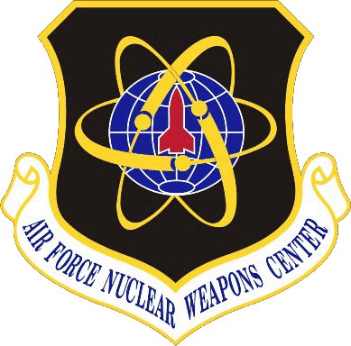
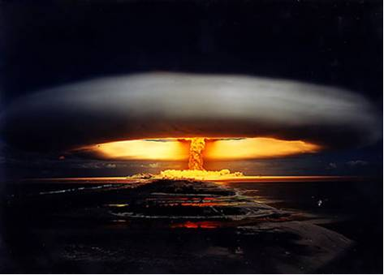
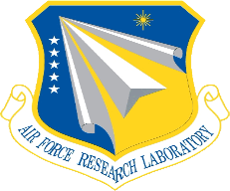

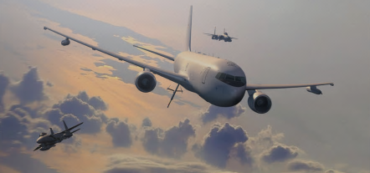
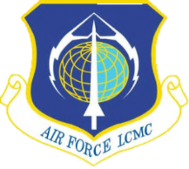
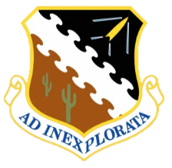
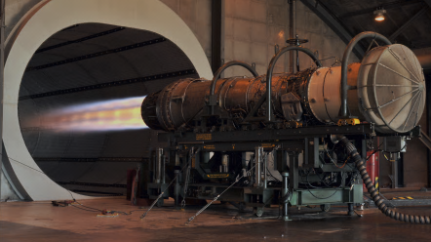
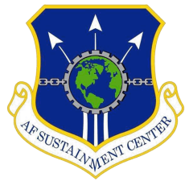
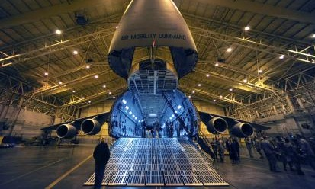
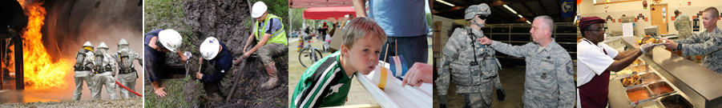
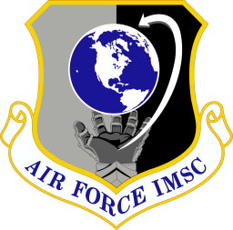
Air Force Materiel Command
Nuclear Systems
Management
Continue to Strengthen AFMC’s
Role in the Nuclear Enterprise
Discovery & Development
Advance Today’s & Tomorrow’s
Combat Capabilities through
Leading-Edge Technology
Life Cycle
Management
Acquire & Support
War-Winning Capabilities
“Cradle-to-Grave”
Perform World-Class
Test and Evaluation
Test & Evaluation
Sustainment
& Logistics
Provide Sustainment &
Logistics Readiness to
Deliver Combat Power for America
Installation
&
Mission Support
Support AF-wide Installation
& Expeditionary
Combat Support Activities
Notes:
The Air Force Sustainment Center is one of the six “centers” in Air Force Materiel Command.
At the top of this slide is the Air Force Nuclear Weapons Center, at Kirtland AFB, NM.
The Air Force Research Laboratory is next, followed by the Air Force Life Cycle Management Center, both headquartered at Wright-Patterson AFB, OH.
Next is the Air Force Test Center at Edwards AFB, CA, followed by the Air Force Sustainment Center at Tinker AFB, OK.
Finally, the newest center is the Air Force Installation and Mission Support Center at Joint Base San Antonio – Lackland, TX.
Together, these six commands “Deliver and support agile war-winning capabilities

Slide 5
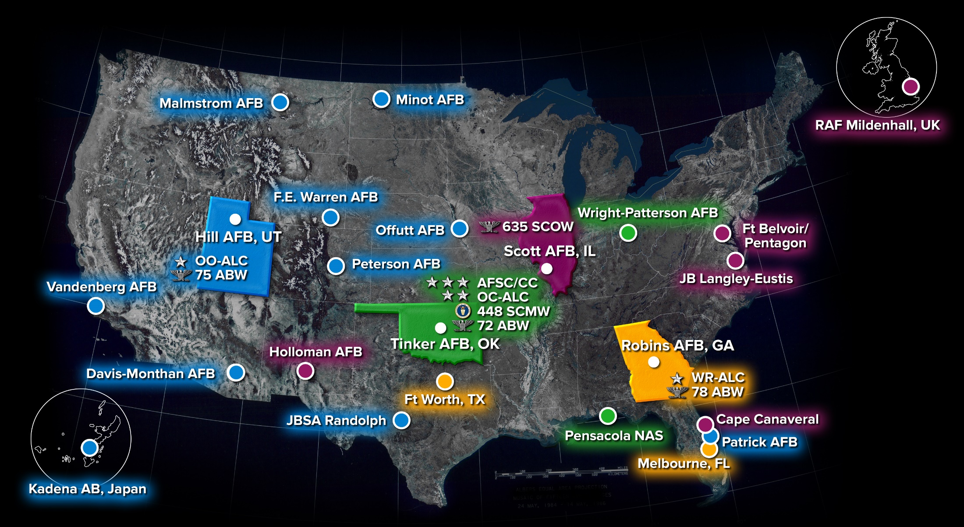
Geographically Distributed
Command Footprint
Notes:
This graphic depicts the footprint of the AFSC across 26 locations in 18 states, Australia, Japan & the UK.
The outlined blue, green, yellow, and magenta states of UT, OK, IL, and GA, highlight the locations of the Complex and Wing headquarters and are associated with the colored boxes on the next slide.
The other colored locations are the subordinate units to the headquarters.
The locations at Kadena Air Base, in Japan and RAF Mildenhall in the United Kingdom support PACAF and USAFE respectively.
Of note, the Air Force Sustainment Center provides on-site missile maintenance at three of the Global Strike Command bases – Malmstrom, F.E. Warren, and Minot.

Slide 6
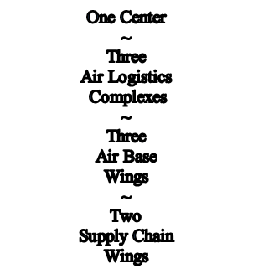
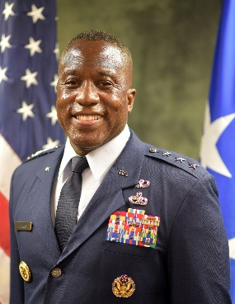
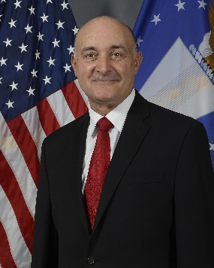
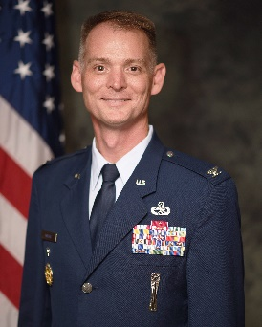
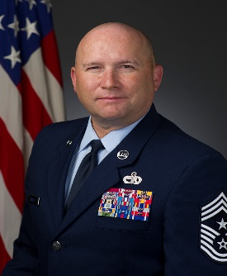
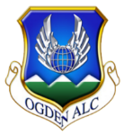
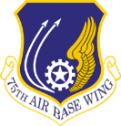
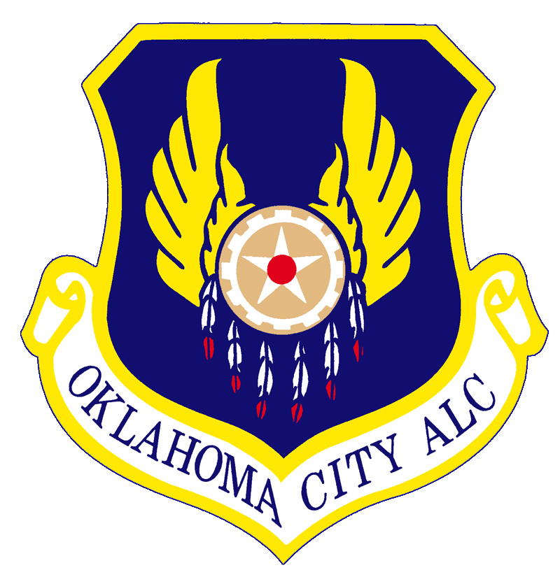
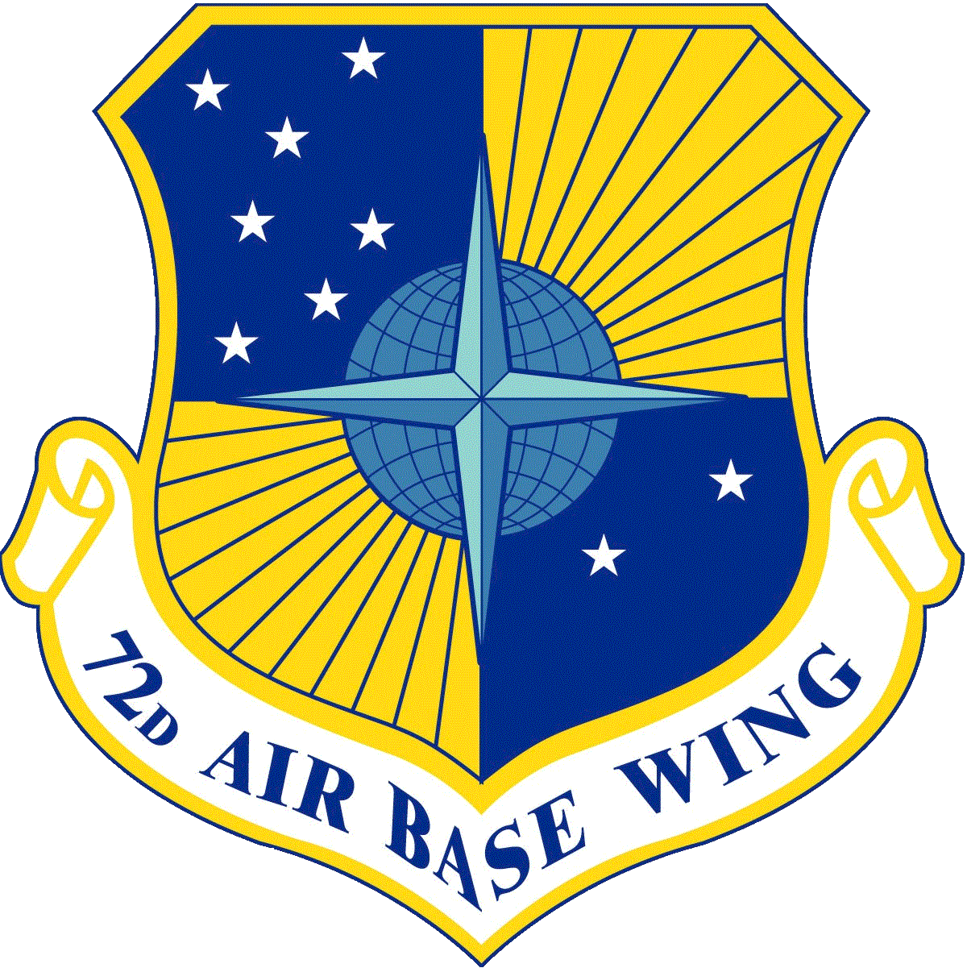
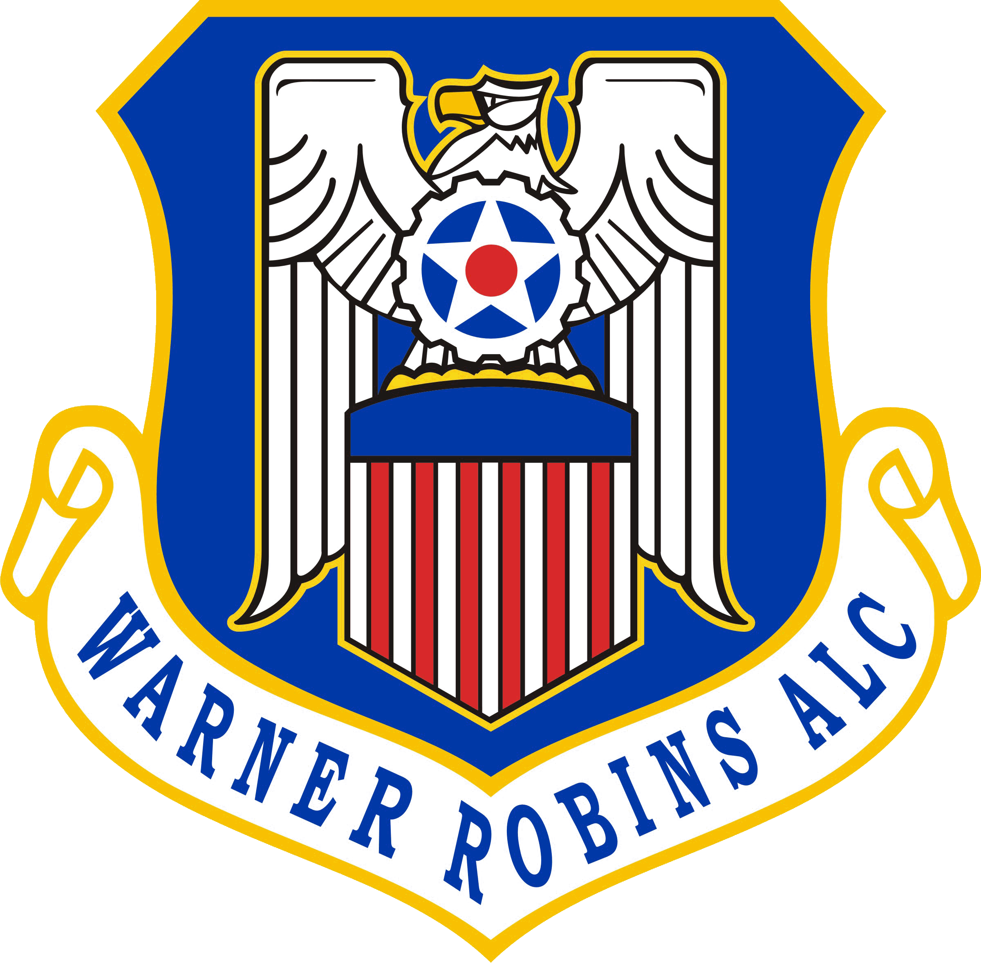
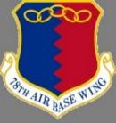
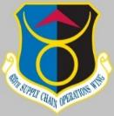
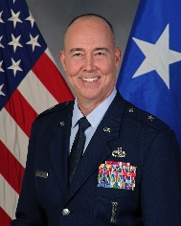
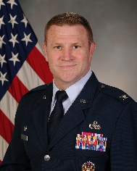
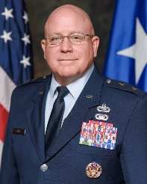
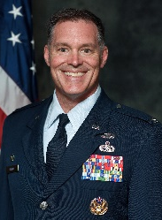
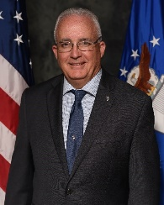
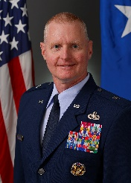
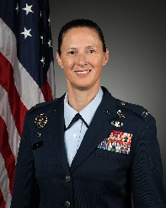
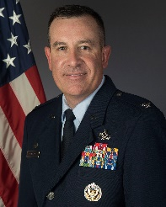
Geographically Distributed Command
Unclassified
Commander
Lt Gen Stacey Hawkins
Executive Director
Mr. Dennis D’Angelo
(SES)
Vice Commander
Col David Miller
Command Chief
Robert Schultz
HILL AFB, UT
TINKER AFB, OK
ROBINS AFB, GA
SCOTT AFB, IL
Brig Gen
Rick Gibbs
Col
Jeffrey Holland
Maj Gen
Jeff King
Col
Hall Sebren
Mr.
Stephen Gray
Brig Gen
Jon Eberlan
Col
Lindsay Droz
Col
Ryan Bakazan
Notes:
The Air Force Sustainment Center is Headquartered here at Tinker AFB and consists of approximately 40,000 military, civilian, and contract personnel.
There are eight Complex and Wing commanders from four bases in UT, OK, GA, and IL that report directly to AFSC/CC, and each one is highlighted in subsequent slides.
In addition to the three Air Logistic Complexes we have three Air Base Wings and two Supply Chain Wings. These commands represent the entire depot capability and the supply chain of the Air Force.
The colors highlight the co-located commands and will be shown again on the next two slides to provide a consistent way to track which activities belong to which organizations within AFSC.
Although these organizations are dispersed geographically, we operate as a single team to deliver combat power.

Slide 7

AFSC Generates Combat Power
F-16, A-10, F-22, F-35, C-130, T-38, ICBMS
Landing Gear
Oklahoma City
Air Logistics Complex
KC-135, KC-46, B-1, B-52, E-3, E-6
Engines
Warner Robins
Air Logistics Complex
C-5, C-130, C-17, F-15
Avionics
91K Exchangeables
73K Exchangeables
123K Exchangeables
OFPs, Msn Planning, Test Equip, Support Equip, Msn Support
OFPs, Msn Planning, Test Equip, Support Equip, Msn Support
OFPs, Msn Planning, Test Equip, Support Equip, Msn Support
Ogden
Air Logistics Complex
Deployable Field Teams
Deployable Field Teams
Deployable Field Teams
WEAPON SYSTEMS
UNIQUE
CAPABILITIES
AIRCRAFT BATTLE DAMAGE REPAIR
COMMODITIES
SOFTWARE
SUPPLY CHAIN
Notes:
This slide has a lot of information on it. It really shows what happens at each of the ALCs:
Ogden Air Logistics Complex (blue) is headquartered at Hill Air Force Base, Utah. The complex provides logistics, support, and maintenance for fighter aircraft: the F-35 Lightning II and F-22 Raptor (5th generation), as well as F-16 and A-10. Additionally, it supports C-130 Hercules, T-38 Talon, and ICBMs.
Ogden is one of the leading providers of software, pneudraulics, secondary power systems, composites and ICBM rocket motors for the DoD. It also specializes in landing gear for the AF and other components in DoD.
As depicted in the previous slide, the Ogden ALC has ten geographically separated locations that perform aircraft, missile and electronics maintenance, regeneration and storage. The 309th Aerospace Maintenance and Regeneration Group (AMARG) located at Davis-Monthan AFB, Ariz., also belongs to the Ogden Complex. The 309th AMARG is our Nation’s Reservoir of Air and Space Power. We recently reclaimed a B-52 from 7 years of storage to return it back to service to meet Global Strike Command mission requirements.
The Oklahoma City Air Logistics Complex, here at Tinker Air Force Base, is one of the largest units in Air Force Materiel Command. The complex performs programmed depot maintenance (PDM) on the KC-135, B-1, B-52, and E-3 aircraft, and expanded phase maintenance on the E-6. The OC-ALC is the “engine complex” for the AF. It provides maintenance, repair and overhaul of multiple engines for the Air Force, Air Force Reserve, Air National Guard, Navy and Foreign Military Sales, including the F-107 engine for the cruise missiles.
Additionally, the complex is responsible for the maintenance, repair and overhaul of a myriad of Air Force and Navy airborne accessory components, and the development and sustainment of a diverse portfolio of operational flight programs, test equipment, and industrial automation software.
The Warner Robins ALC provides depot maintenance, engineering support, and software development to F-15, C-5, C-130, and C-17 aircraft. While Odgen is the “Landing Gear” depot, and OKC is the “Engine” depot, Warner Robins is the “Avionics Depot” for the Air Force and it provides combat-ready avionics parts and services to our warfighting forces, including for some of our nuclear components, such as the ALCMs.
A key “take away” from the Air Logistics Complex slides is that it takes all three to sustain a single weapons system – the airframes, landing gear, engines, and avionics.
It also takes all three Complexes to sustain critical components of the nuclear enterprise.
At the bottom of the slide is our supply chain that underpins the entire enterprise from strategic sourcing, nuclear weapons related materials, fuels, vehicles, and item management and distribution.
Together, these ALCs and the supply chain provide significant strategic value for our nation.

Slide 8
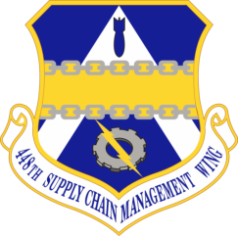
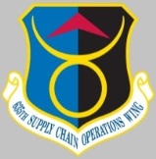
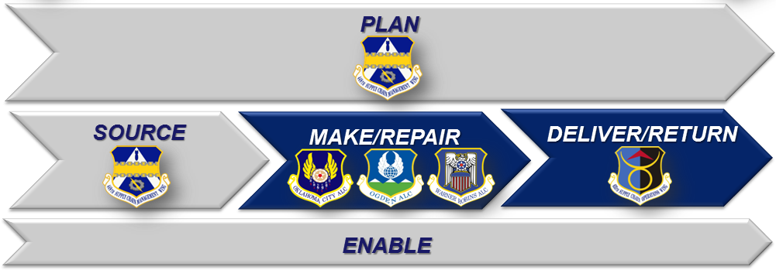
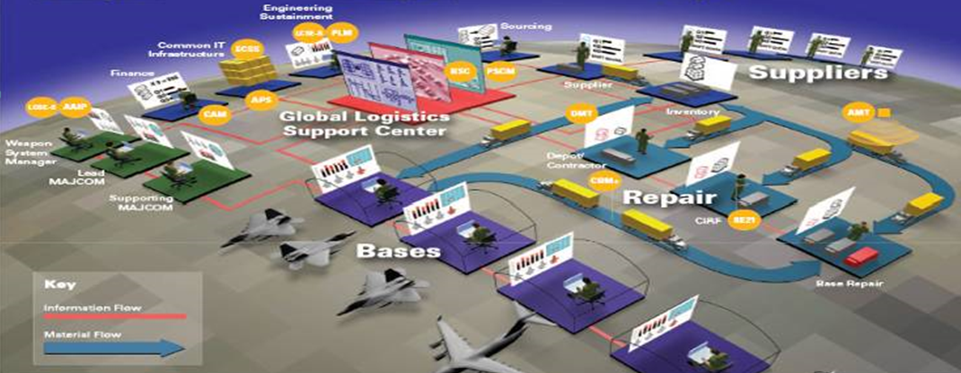
Supply Chain Wings
448th Supply Chain
Management Wing
~ Tinker AFB ~
635th Supply Chain
Operations Wing
~ Scott AFB ~
Single Air Force wholesale Supply Chain Management Wing
Management of critical items for the nation’s nuclear enterprise
Warfighter support through lens of Weapon Systems Asset Availability
Plan and execute repairable spares requirements
$7.2B budget authority
50+ partner nations
First-responders 24/7/365 for retail supply
100% Positive Inventory Control of Nuclear Weapons Related Materials (NWRM)
WRM global management
Vehicle/Equipment Mx Support (VEMSO)
AF Petroleum Agency (AFPET)
Basic Expeditionary Airfield Resources (BEAR)
Consolidated Mobility Bag Agency (CMBA)
Accurate & timely reporting of supply chain information for warfighter visibility
Notes:
The 448 SCMW (left side) is essentially “wholesale” and the 635 SCOW (right side) is essentially “retail” for AF supply requirements
In a Supply Chain Operations Reference Model depicted on the left side, the 448th does “Plan and Source,” the ALCs do “Make and Repair,” and the 635th does “Deliver and Return”
The 448th manages critical items for our nuclear enterprise.
It also supports our warfighters by paying careful attention to asset availability and plans ahead to make sure that we have the right parts on the right shelves at the right time.
The 448th also works closely with over 60 partner nations. This support network is part of our Foreign Military Sales agreements.
The 635th SCOW is the supply chain’s first responder. Their goal is to provide any customer the parts and information they need to meet their requirements 24 – 7 – 365.
On the right side of the slide you see a graphic that represents a flight line that identifies a need for a supply item, the information flow from the maintenance shops through the supply management organizations to the suppliers, and then the distribution of an item from a supplier back to the flight line.
They are also responsible for 100% Positive Inventory Control for nuclear weapons related materials, WRM global management, vehicle and equipment maintenance support, and the AF petroleum agency.
The 635th is also responsible for all Basic Expeditionary Airfield Resources (BEAR) through the 635th Materiel Maintenance Group at Holloman AFB, NM, as well as the Consolidated Mobility Bag Agency at Wright-Patterson AFB, OH.
Basically, all the combat enablers, such as POL, ammo, vehicles, support equipment, and WRM are managed through the 635th.

Slide 9
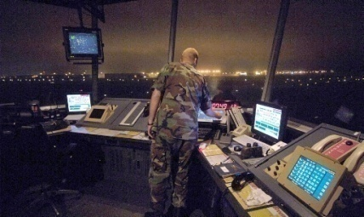
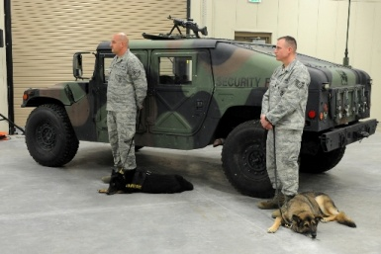
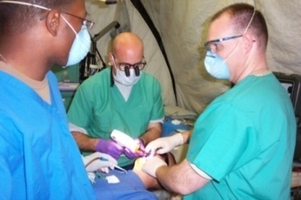
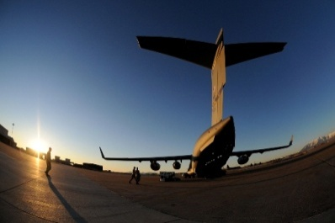
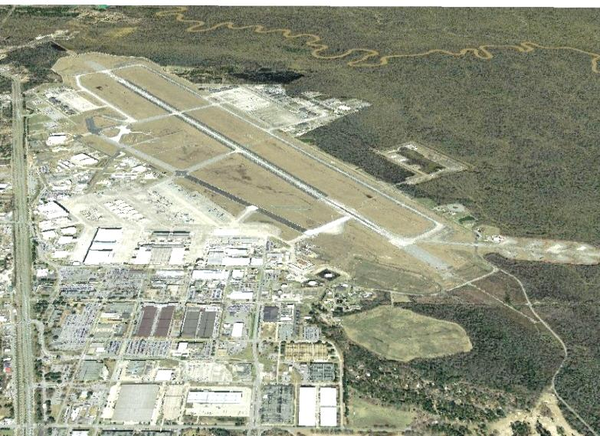
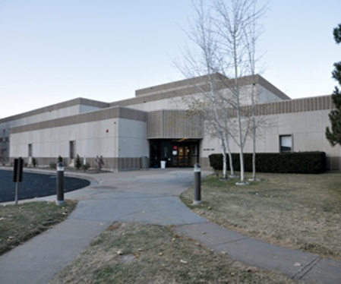
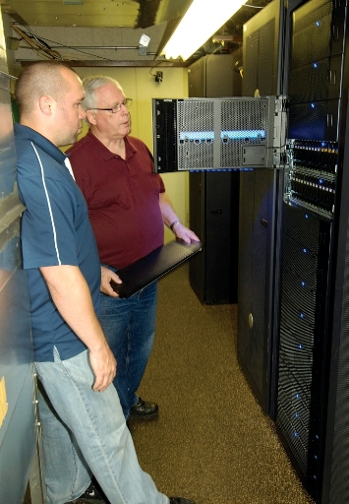
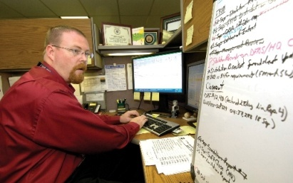
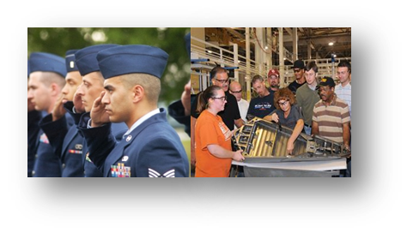

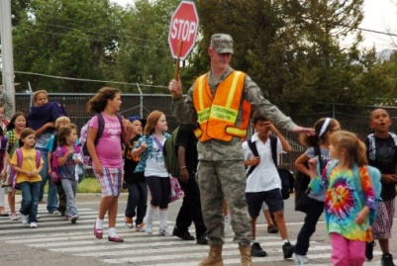
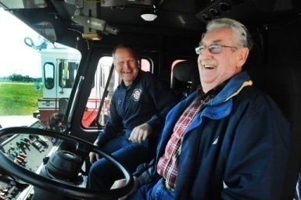
Air Base Wings
Airfield Management
Installation Security
Medical Support
Mission Support
Facilities/Infrastructure
Information Technology
Financial Support
Contractors
Families
Retirees
Airmen
Notes:
The three Air Base Wings in UT, OK, and GA are Power Projection Platforms. The Air Base Wings provide installation support to over 140 Associate Units with more than 75,000 personnel.
They not only enable the complexes to perform their critical work, they also directly enable some of our nation’s most important combat wings by providing an airfield, force protection, and installation support for the mission and personnel.
At Hill, the 75 ABW supports the 388th and 419th Fighter Wings, including the first combat coded operational Air Force F-35 squadron, the 34th FS.
Here at Tinker, the 72 ABW supports the 552d Air Control Wing, the AF’s only E-3 AWACS wing, as well as STRATCOM Wing One, and the 507th Air Refueling Wing (AF Reserve KC-135).
At Robins, the 78 ABW supports the 461st Air Control Wing, the AF’s only E-8 JSTARS Wing, and the 116th Wing, GA ANG.
The ABWs also proudly support other key mission partners, such as NAOC (National Airborne Operations Center).

Slide 10
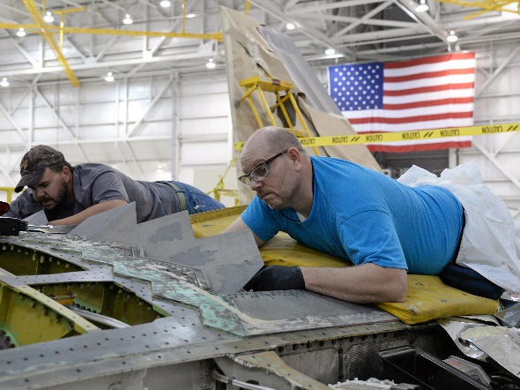
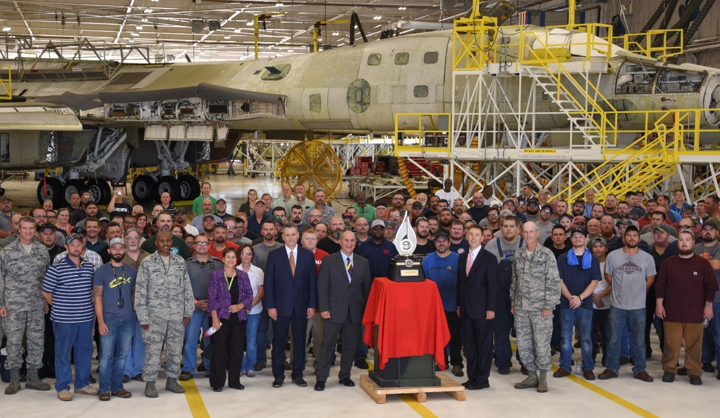

Workforce
Recruiting & Retention
  DHA/EHA, Incentives & Competitive Benefits, 180-Day Rule
Notes:
Earned more business due to our successes
- Recruiting & Retention
-- Direct/Expedited Hiring Authority (DHA/EHA)
-- Incentives & Competitive Benefits
-- Speed…faster hiring; 180-day rule

Slide 11
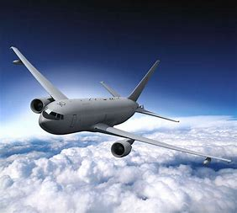



Plan for the Future
Notes:
KC-46, F-35, B-21
Branding & Marketing
Predictive/Precise Comps
Evolving Comps
Industrial Relationship Management
Source of Repair (SOR) of Choice – being the source of selection, and not by direction!

Slide 12








National Strategic Nuclear Deterrent
Bombers
Navy TACAMO
Dual Capable Aircraft
Air-Launched Cruise Missiles (ALCM)
Nuclear Command, Control & Communications
(NC3)
Inter-Continental Ballistic Missiles (ICBM)
ICBM Launch Control
Notes:
The AFSC is the Air Force’s Readiness Engine for Nuclear Sustainment.
In previous slides, we highlighted our sustainment of the hardware – aircraft and missiles. We also provide direct support to nuclear enterprise software systems.
At Tinker, our software teams support ALCM test software and mission planning software for the B-52 and B-2. We also support the software that provides the interface between the nuclear weapons and the aircraft.
At Peterson AFB, a geographically separate unit of the Ogden complex, we support software for NC3 (Nuclear Command, Control, and Communications). Specifically, we support Air Force Command Post Terminals (AFCPT), Milstar Messaging Application (MMA), and ICBM Telemetry Information Processing Systems (ITIPS).
We will also support the new Space Fence with software maintenance when it becomes operational. [2018]
Additionally, we will support NC3 systems such as the Family of Advanced BLOS Terminals (FAB-T), the Global Aircrew Strategic Network Terminal (Global ASNT), and the Minuteman Minimum Essential Emergency Communications Network.

Slide 13


Art of the Possible
How We Sustain Momentum…Strategic to Tactical Execution
Tenets of AoP
  Leadership Model
  Flow Principles
  Science of Throughput
  Data Driven Decisions
  Constraint Resolution
  Radiator Chart
  Wall Walk
  Tactical Management
Notes:
Art of the Possible is a constraints based system designed to create an environment for success by:
Creating a culture of problem-solvers
Defining processes (aka machines)
Eliminating constraints
Continuously improving
The core tenets of AoP include:
Leadership Model: The Leadership Model is the foundation of AoP that guides AFSC’s management approach, creating an environment for success. The model drives us to meet our common goals through three collective components: Developing our people, Managing our resources, and Improving our processes. Through these collective components, we create an environment where we can achieve the Art of the Possible.
Flow Principles: Flow is the action of moving along in a steady continuous stream of adding value; it is the orderly movement of work through a series of established steps. When we define flow, we find where work stacks up = system constraints. We resolve constraints and continue to monitor flow, improving flow each time we resolve a constraint.
Data Driven Decisions: If you are not monitoring the system, you are failing. You must trend performance of the processes within each gate to identify constraints to the system and point where CPI efforts should be directed.
Constraint Resolution: Premise is production systems act much like a chain…only as strong as their weakest link. The weakest link in a production operation is constraint which prevents output of entire system from meeting desired performance.
Radiator Chart: The Radiator Chart is the way we execute our game plan and the standardized set of operating principles by which we set up process machines. The elements on the chart touch every part of the enterprise:
The horizontal elements are how the machine is set up
The vertical elements enable the machine to work effectively and efficiently
Wall Walk: Provides process improvement overview in terms of machine gates. It identifies gaps and improvement opportunities and requires understanding of what is impacting machine/gate. Wall Walks enable organizational learning and require involvement at all levels to be effective. Wall Walk essentials are Flow, WIP, and Gate Performance.
Tactical Management: At the tactical level, progress of the individual project is tracked visually against a critical path or critical chain. It offers a visual representation of the project activities, presents the time to complete task and overall project, tracks activities, helps synchronize work, and allows focus on the most important steps. It is the way to answer the question: how do you know you are having a good day?

Slide 14
Global Logistics
Depot and Modification
Aircraft Battle Damage Repair (ABDR)
Global Supply Chain Integration and Execution
War Reserve Materiel (WRM)
Standard Air Munitions Packages (STAMP)
Software Sustainment, Modification, Enhancement
Combat Enablers: POL, Vehicles, Support Equipment
ABWs are Power Projection Platforms
“Art of the Possible” is how AFSC Enterprise operates
Notes:
AFSC is more than the Air Force’s aircraft maintenance and modification centers.
We hold most of the Air Force’s deployable field teams that will conduct aircraft battle damage and repair.
We are the Global AF supply chain manager, including acquiring and managing War Reserve Materials to support Combatant Commanders and managing the combat enablers that our warfighters depend on.
At Hill AFB, we have a Standard Air Munitions Package mission where we build munitions pallets to support warfighter requirements.
Our complexes provide software sustainment, modifications, and enhancements to support weapons systems and support equipment, including nuclear communications systems.
Our air bases enable and project combat power.
We have a global AOR and we stand ready to support any Combatant Commander to deliver combat power for America.
We do all of this with through the “Art of the Possible.”

Slide 15




























We are AFSC
15

Slide 16


Software Enterprise
Notes:
As mentioned previously, software is our fastest growing area
Today’s 5th Generation weapon systems are really hardware systems surrounded by software packages
The new KC-46 aerial refueling tanker has more software lines of code (15M) than the F-35, F-22, B-2 and F-16…COMBINED!!! (12.7M)
Our three software groups operate as a true enterprise — leading our Center on functional collaboration
This is a recruiting challenge as well…we’ve really honed in on those Science, Technology, Engineering & Math (STEM) skill sets – STEM Education & recruiting is KEY!

